Slide 1
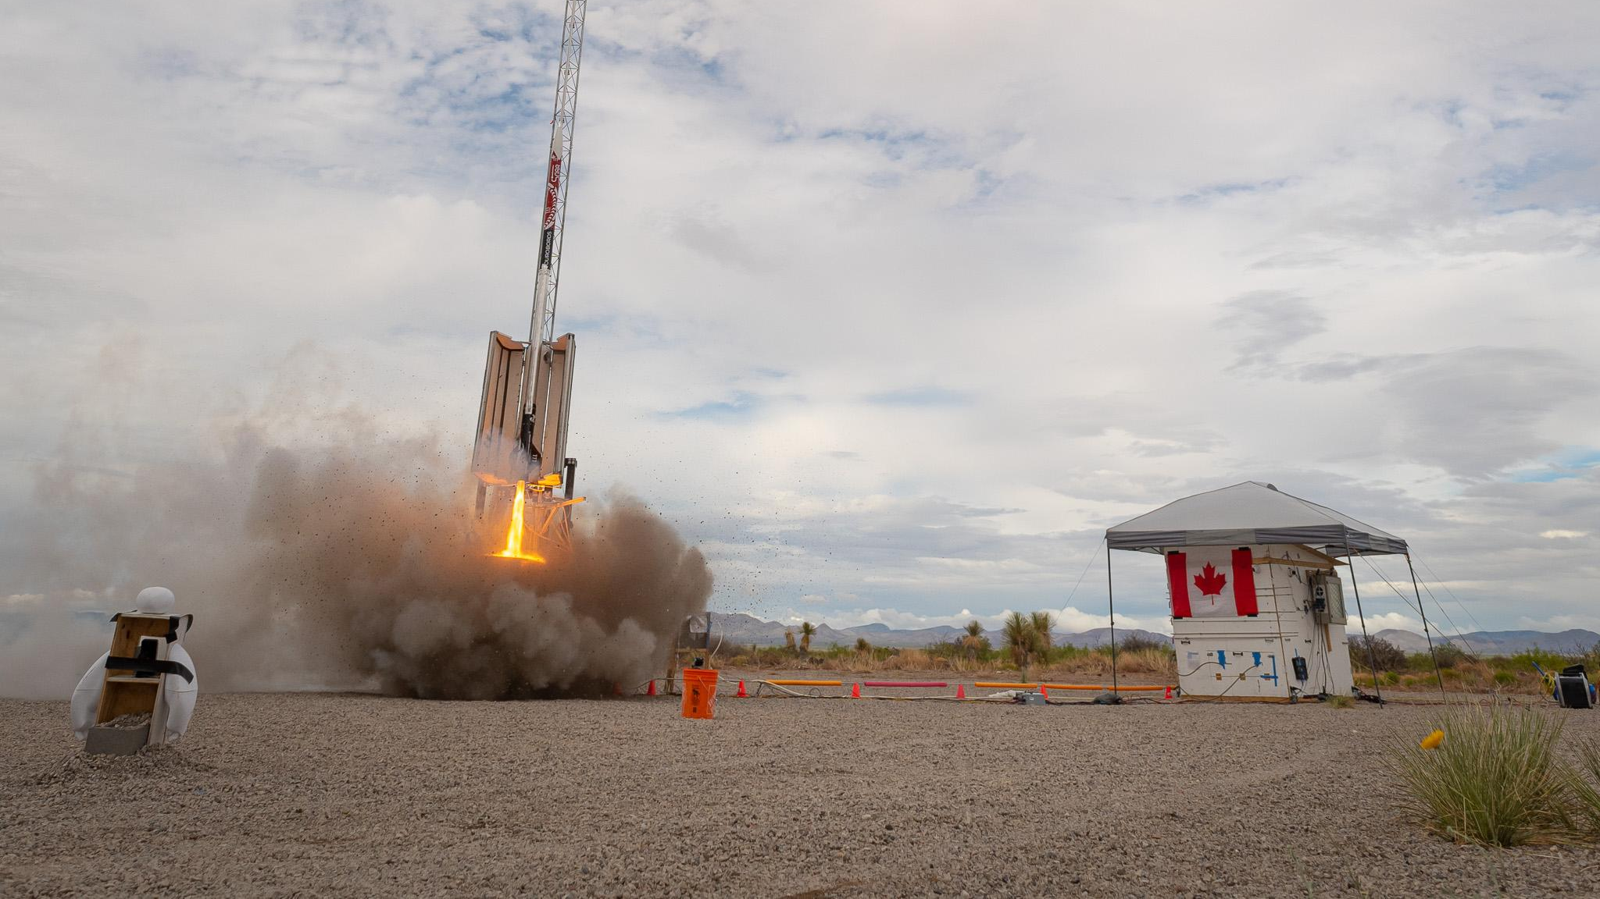

LRB Design Review
November 2025

Slide 2
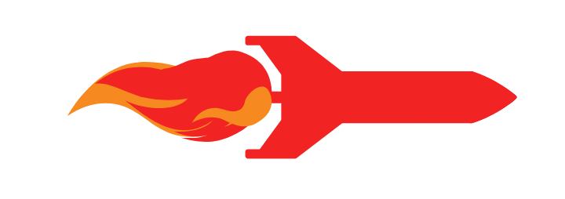

Research Mission
Overview
Student Organization for Aerospace Research

Slide 3
Purpose
Launch Rail Board (LRB)
Replacing the Signal Observations Board (SOB) from Ouroboros
Interface with Anemometers, Thermocouples, and Load Cells by launch rail
Communicates with FSB over simplex UART via RS485 to communicate data
Student Organization for Aerospace Research

Slide 4
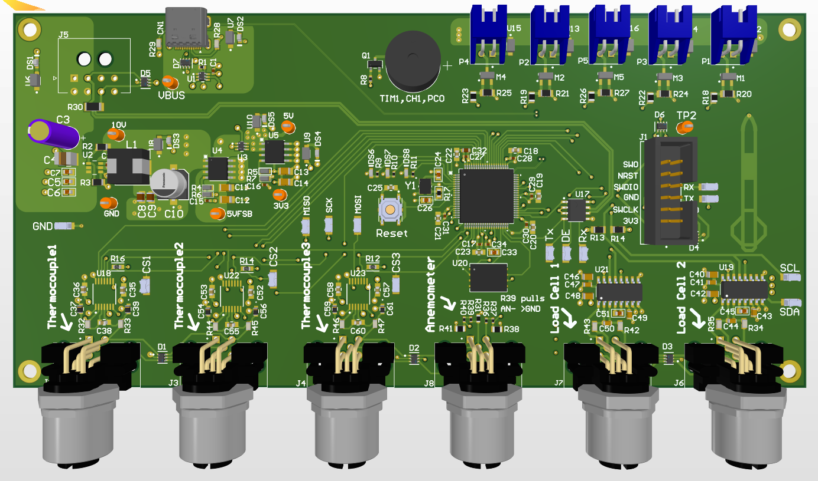
Physical Board
Board is on launch rail
Encased in waterproof housing
Student Organization for Aerospace Research

Slide 5
Research Mission
FSB Connection
Student Organization for Aerospace Research

Slide 6
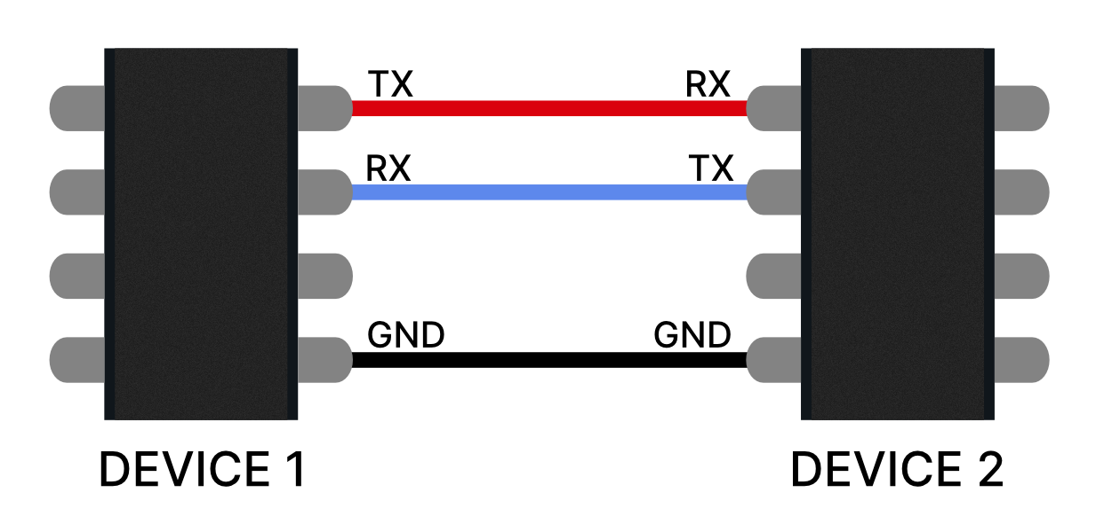
Connection
Provide Power: 48V DC
Communicates using simplex UART over RS-485 twisted pair
Student Organization for Aerospace Research

Slide 7
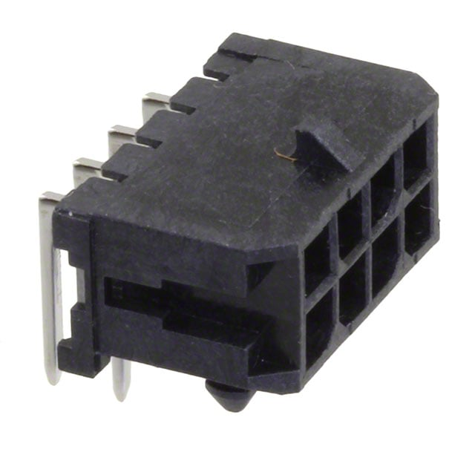
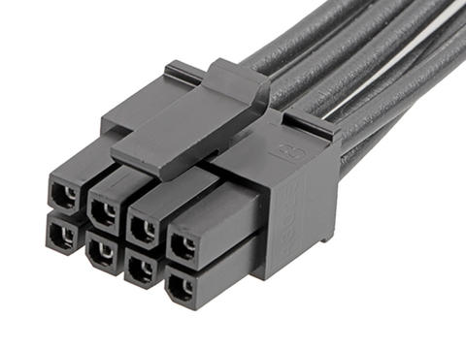
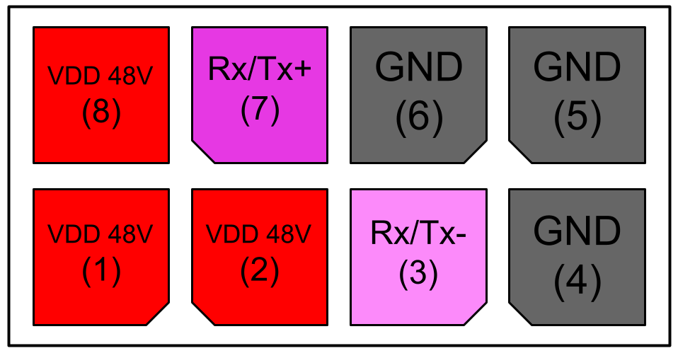
Connectors
Off board 8 pos keyed Molex
On PCB and cable goes to box edge waterproof connector
Header: 0430450800 https://www.digikey.ca/en/products/detail/molex/0430450800/252529
Cable: 2147561082 https://www.digikey.ca/en/products/detail/molex/2147561082/12180697?s=N4IgTCBcDa4IwBYDsBWAbHADADggXQF8g
Student Organization for Aerospace Research

Slide 8
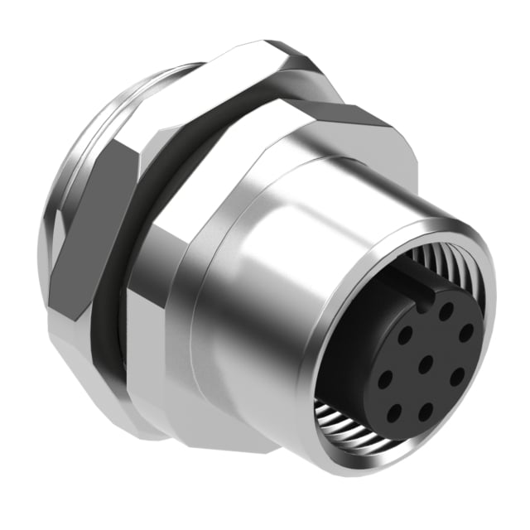
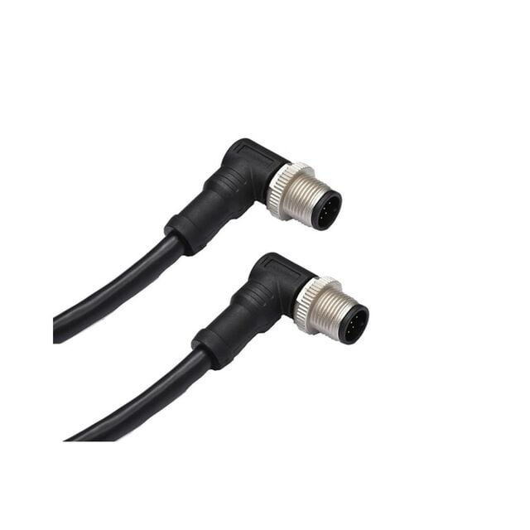
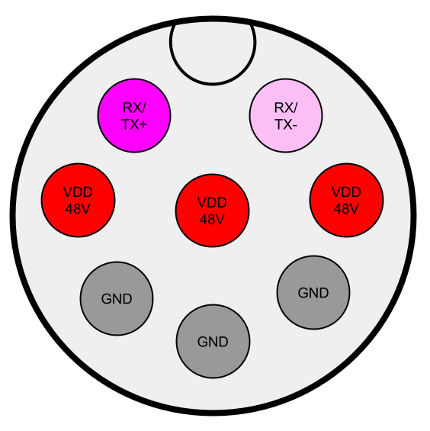
Connectors
Off board 8 pos waterproof circular connector
Communicates using simplex UART over RS-485 twisted pair
Box Edge: 54-00184 https://www.digikey.ca/en/products/detail/tensility-international-corp/54-00184/13548494
Cable: M12A08MR-12AMR-SD005 https://www.digikey.ca/en/products/detail/amphenol-ltw/M12A08MR-12AMR-SD005/21315761
Student Organization for Aerospace Research

Slide 9
Research Mission
Power Regulation
Student Organization for Aerospace Research

Slide 10
Over View
48V FSB
LDO 5V
Buck 10V
LDO 3V3
USB 5V
48V in from Fill Systems Board
Buck converter down to 10V
LDO down to 5V
5V LDO or USB power through another LDO down 3V3
Student Organization for Aerospace Research

Slide 11
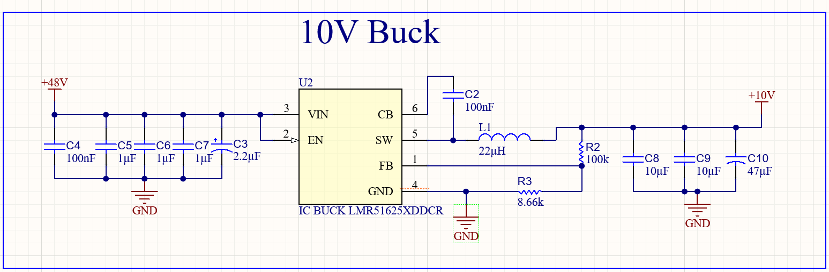
Buck
TPS54561DPRT Buck
Layout from Webench SVG
Vout=10V, Vref=0.8V
Lots of smoothing, bulk capacitance
Rfbt=100k, Rfbb=8.66k, Rfbt/Rfbb=11.547, Rfbt/Rfbb=(Vout-Vref)/Vref=11.5
Student Organization for Aerospace Research

Slide 12
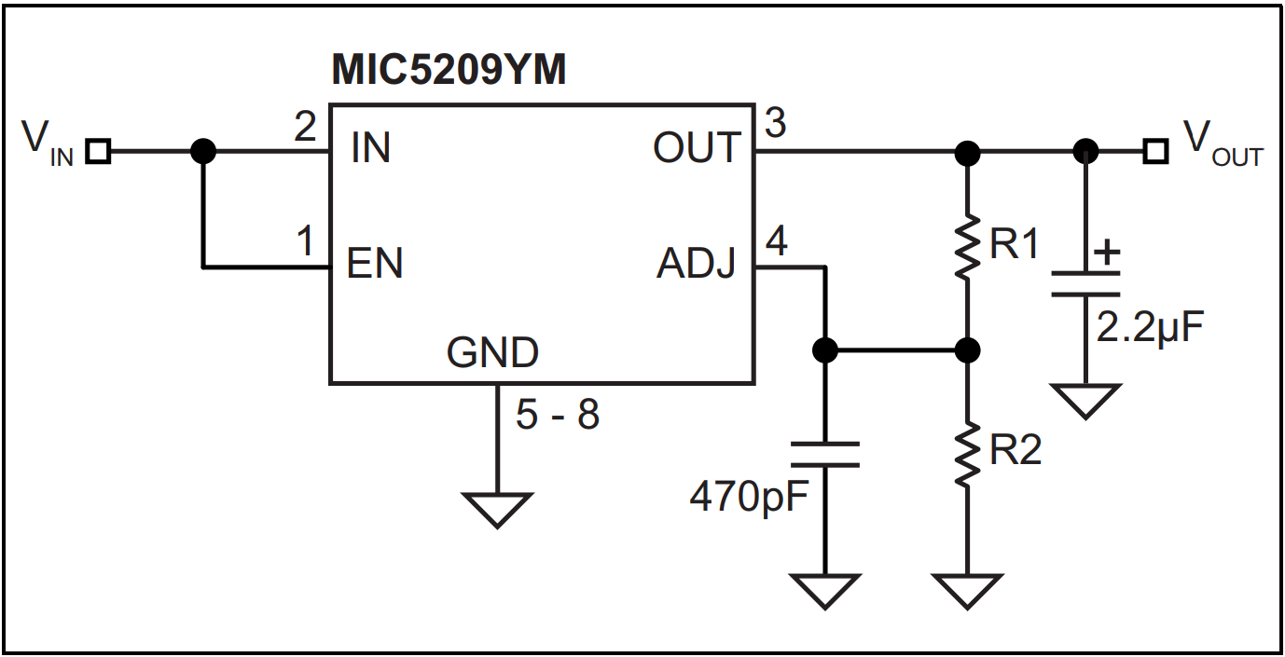
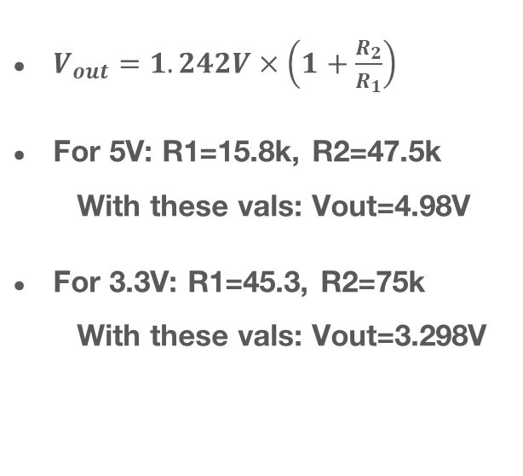
LDOs
$V_{out}=1.242V×\left(1+\frac{R_{2}}{R_{1}}\right)$
For 5V: R1=15.8k, R2=47.5k
With these vals: Vout=4.98V
For 3.3V: R1=45.3, R2=75k
With these vals: Vout=3.298V
Student Organization for Aerospace Research

Slide 13
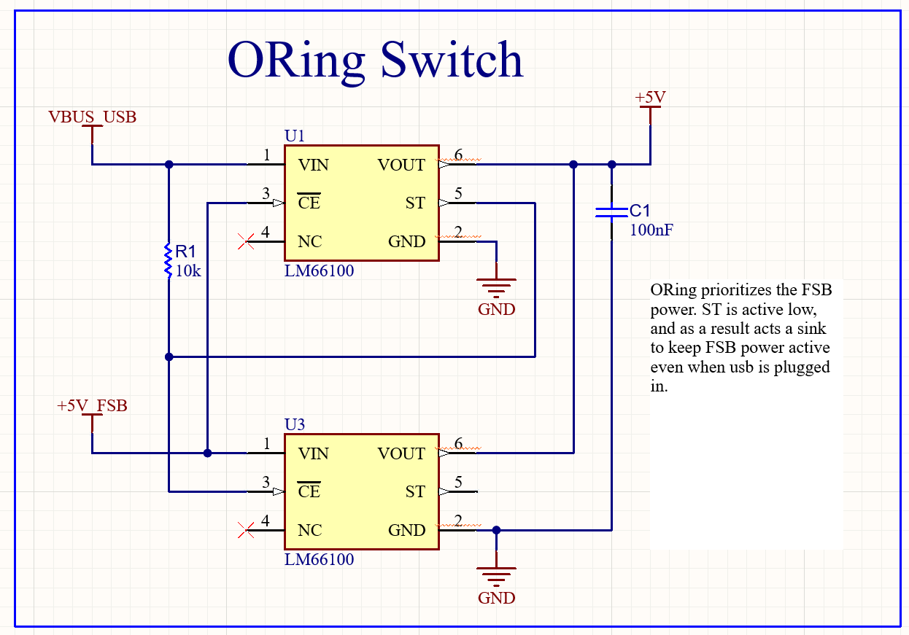
USB Power and ORing
ORing Circuit prioritizes power from the FSB over the USB
Student Organization for Aerospace Research

Slide 14
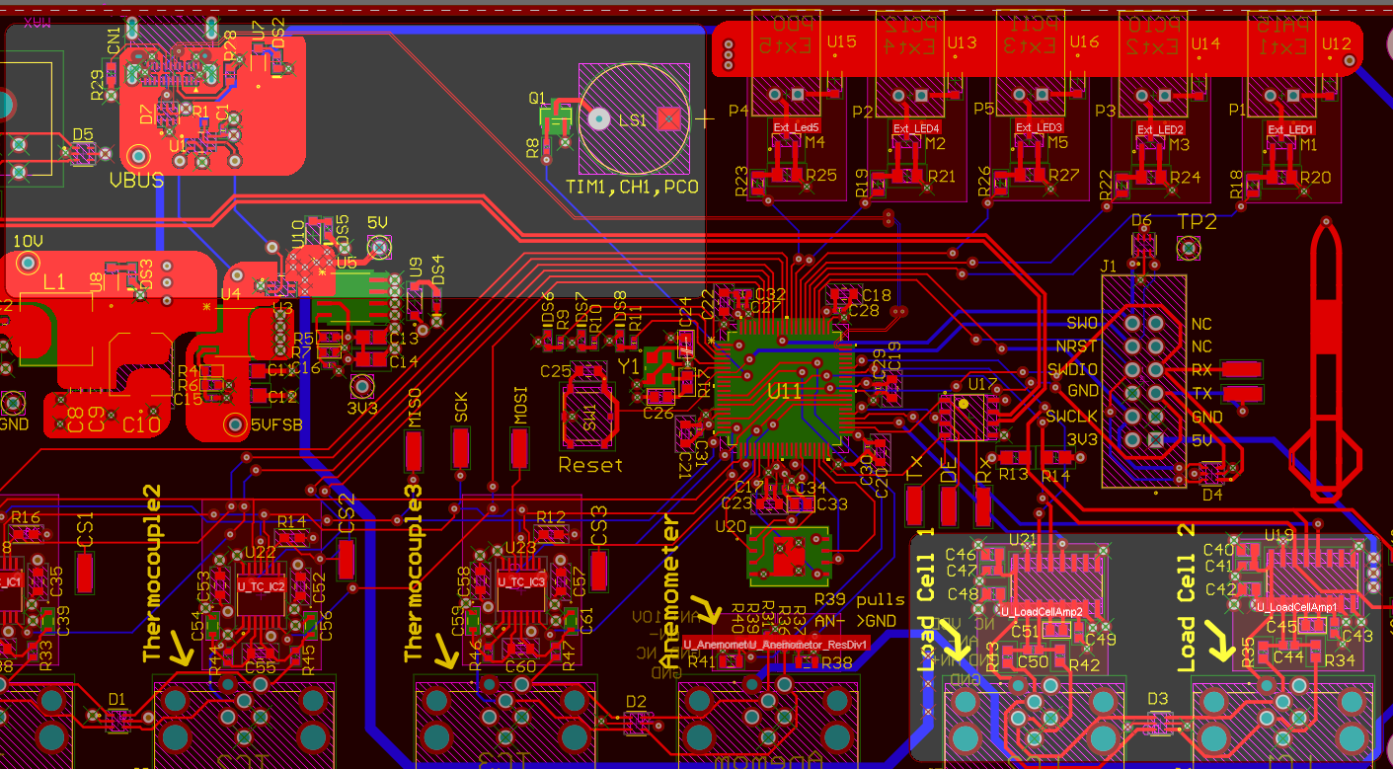
Split Power Plane
The third layer of the board is a power plane
It has two 5V sections
So like hopefully that isn’t a problem
If it is I probably won’t change it so like…
We can pray together
Student Organization for Aerospace Research

Slide 15
Research Mission
Sensors
Student Organization for Aerospace Research

Slide 16
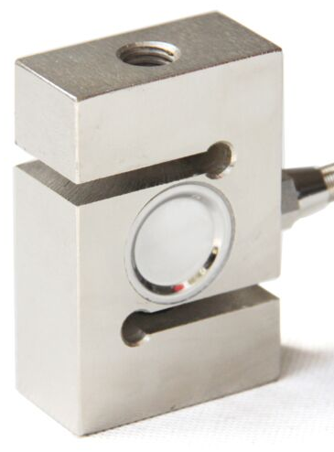
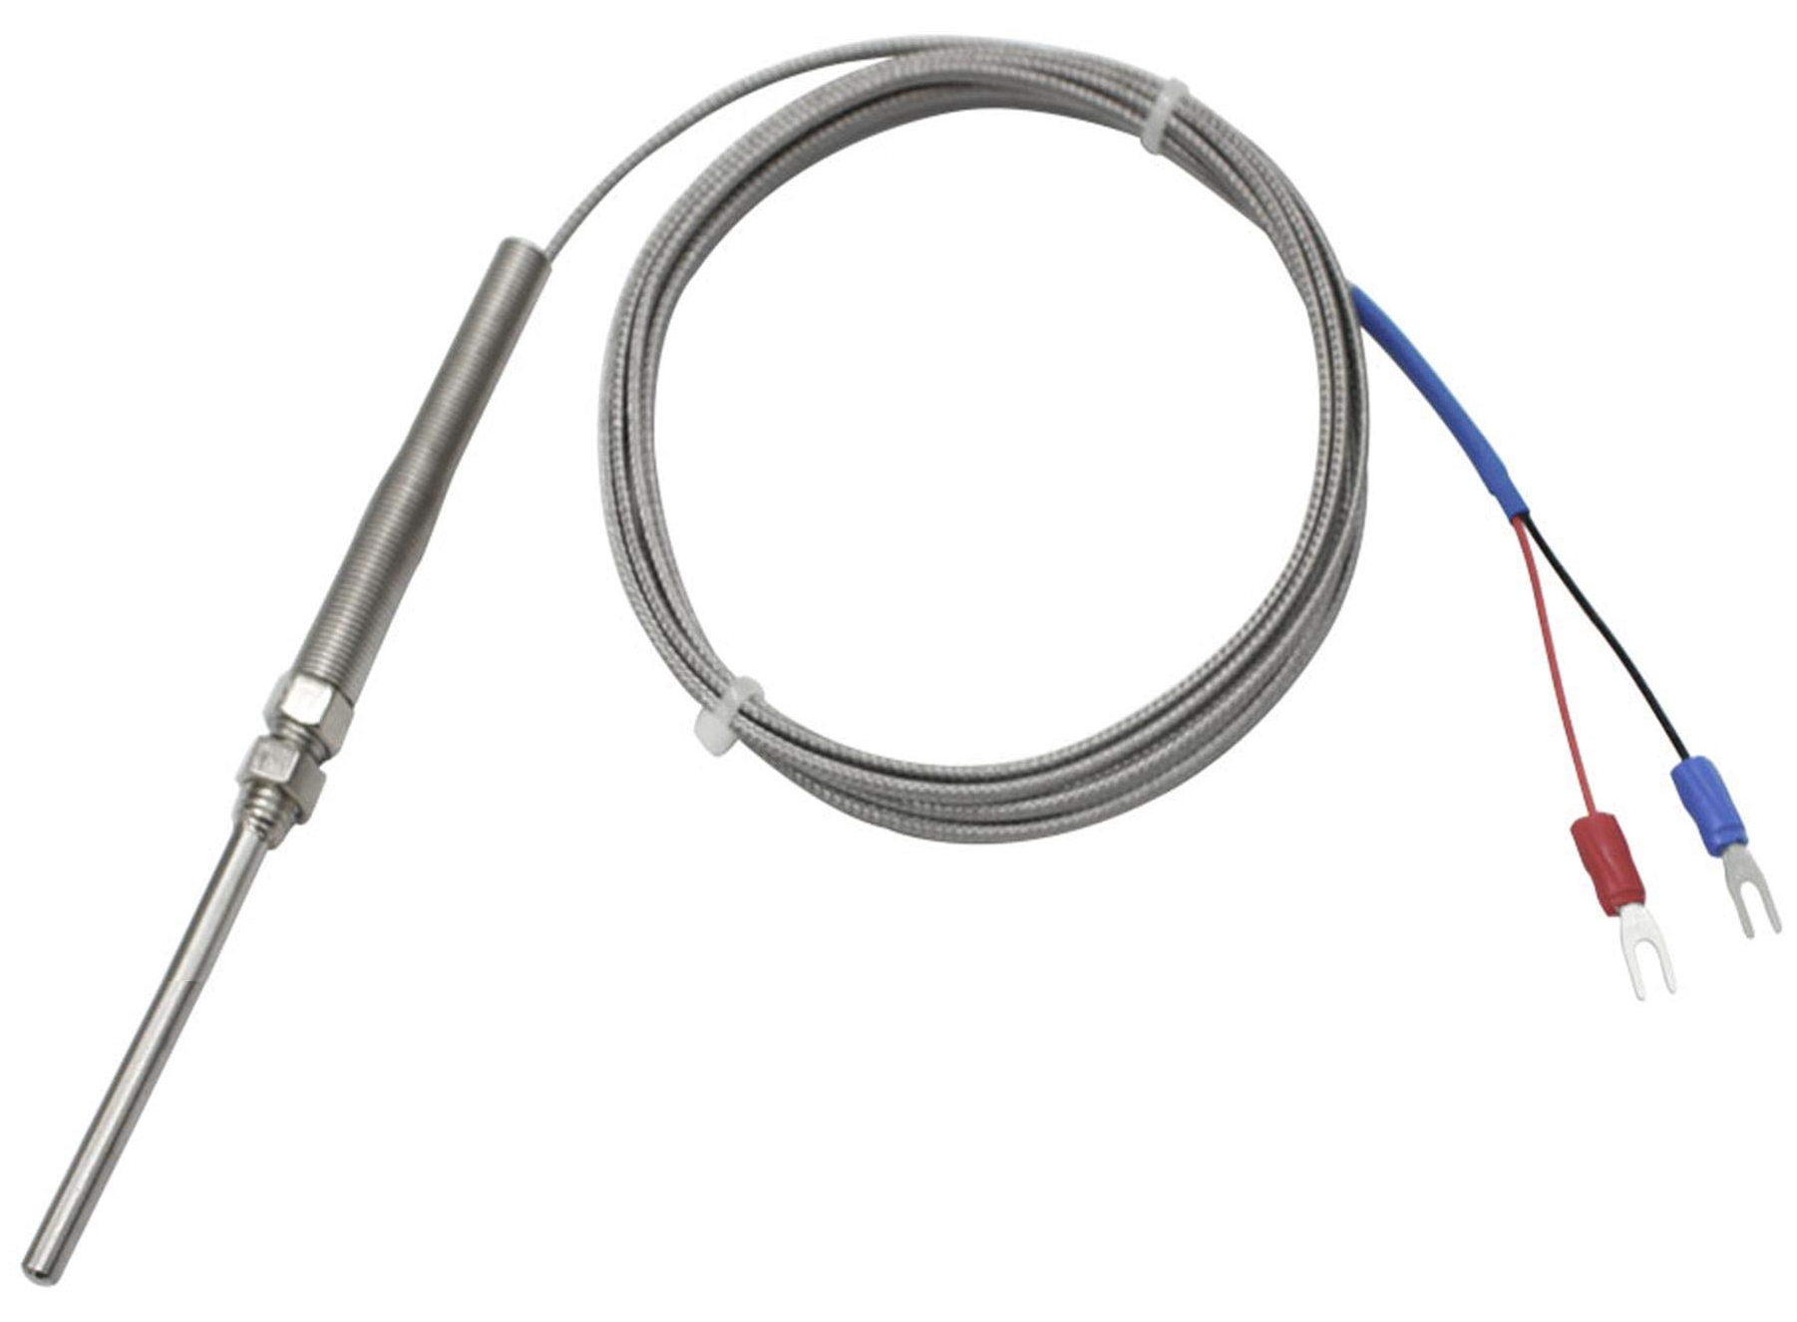
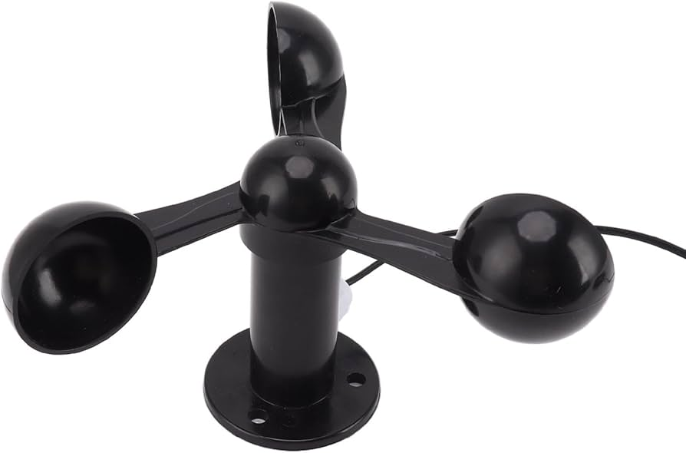
Sensor Overview
3x Thermocouples (TC) – Using AFE with SPI output
2x Load Cells (LC) – Using AFE with I²C output
1x Anemometer: Analog output through resistor divider to MCU ADC
Student Organization for Aerospace Research

Slide 17
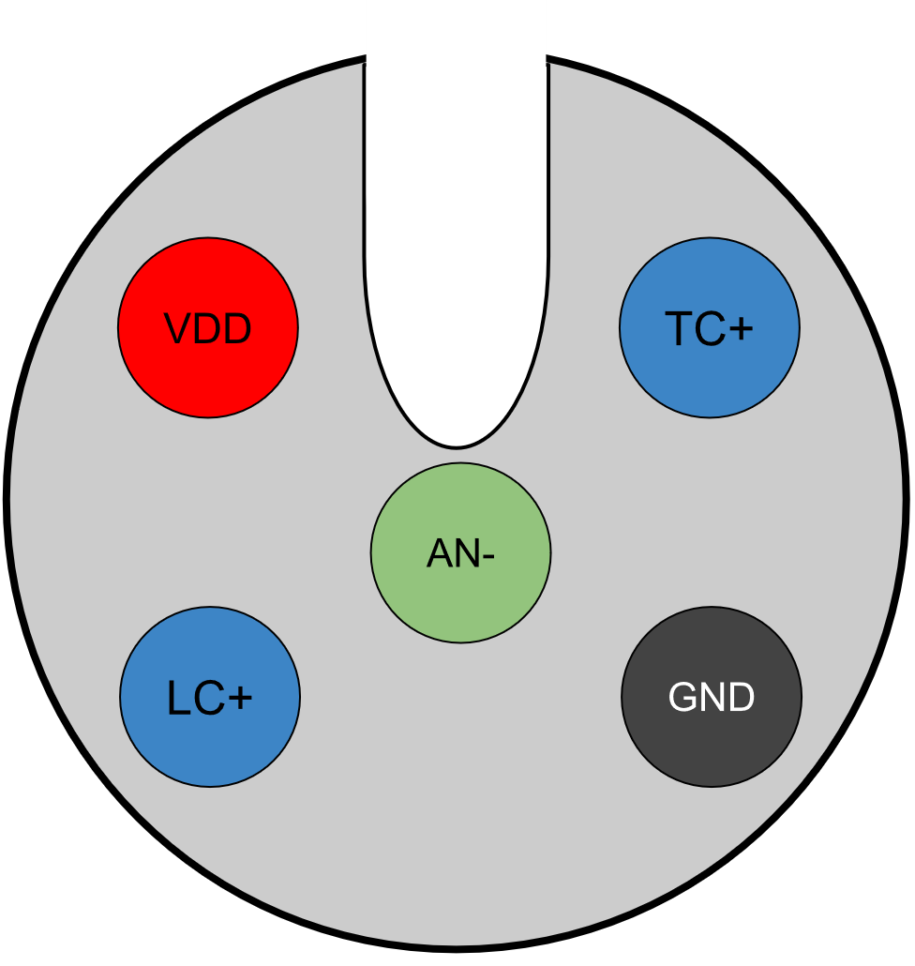
Sensor Connector
M12 screw, 5 position circular board to wire connector 54-00247
All sensors use the same connector
Waterproof box edge connector:
https://www.digikey.ca/en/products/detail/tensility-international-corp/54-00247/13548445
Cable:
https://www.digikey.ca/en/products/detail/tensility-international-corp/50-00960/13548425
Student Organization for Aerospace Research

Slide 18
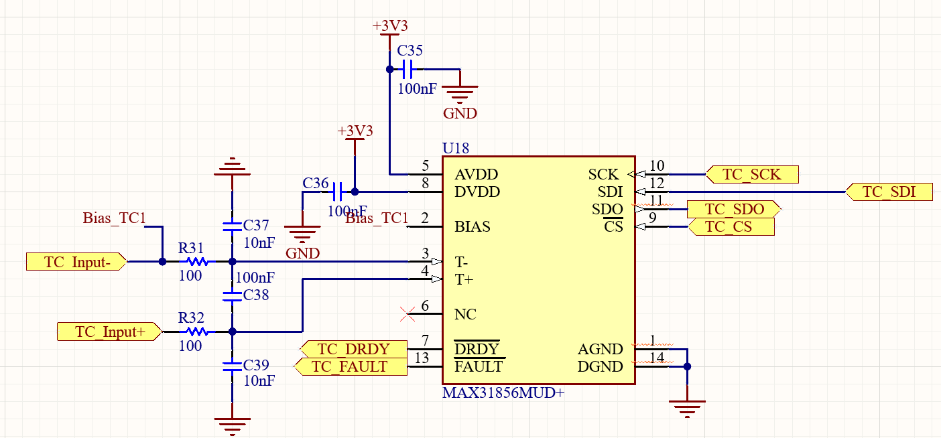
Thermo Couples
Took this from the Sensor Dev Board so if anything is wrong blame Will
Uses SPI. The CS has a pull up in the MCU schematic doc
Student Organization for Aerospace Research

Slide 19
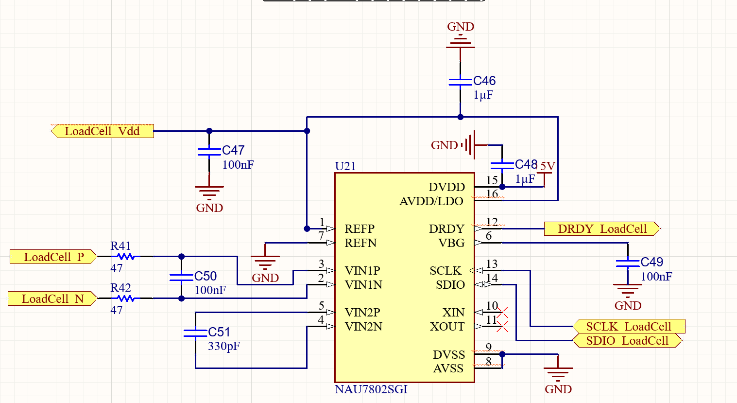
Load Cells
Took this from the Sensor Dev Board so if anything is wrong blame Will
Uses I²C. The SCL and SDA has a pull up in the MCU schematic doc
Student Organization for Aerospace Research

Slide 20
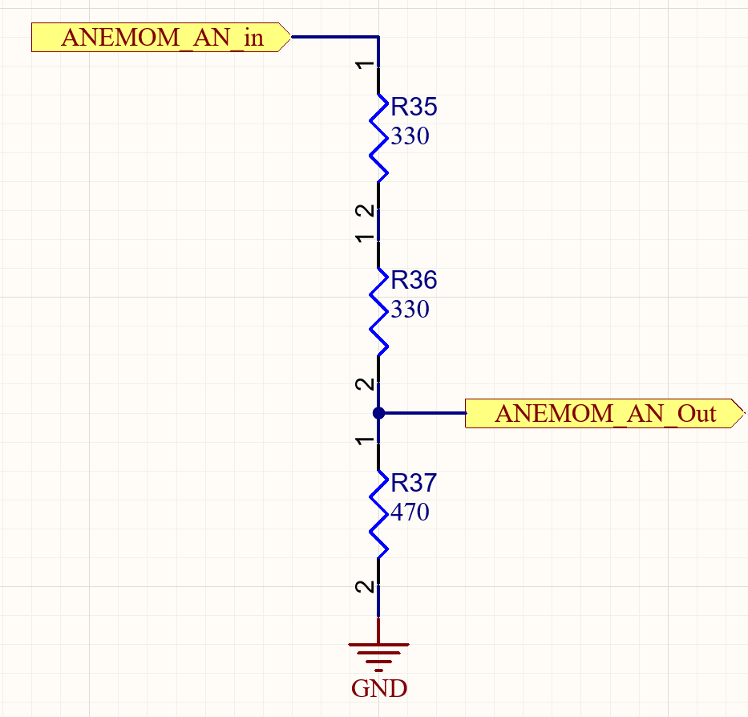
Annemometer Sensor
Hold your applause for this one
This one is all me, Will did none of this
Output connects to MCU ADC
Student Organization for Aerospace Research

Slide 21
Research Mission
Memory
Student Organization for Aerospace Research

Slide 22
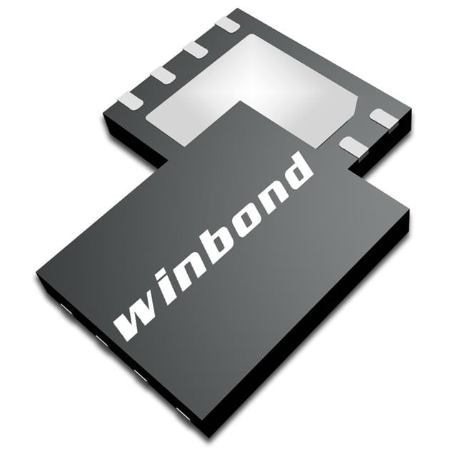
Flash Memory Chip
Using W25N04KVZEIR
4Gbit capacity
QuadSPI Interface to QuadSPI1 on STM
16bit * 4sensors + 32bonus bits = 96bit/sample
(96bit/sample)*(1000samples/s)*(1byte/8bits) = 12kB/s`
For 6 hours we need 259.2MB or 2073.6Mbit
Student Organization for Aerospace Research

Slide 23
Research Mission
USB File System
Student Organization for Aerospace Research

Slide 24
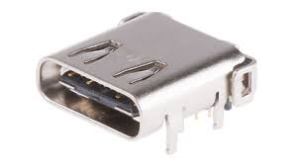
USB C Interface
USB C connection for FS data transfer and low voltage power supply
USB data differential pair with an impedance of 90Ω which causes a trace width of 4.3mils (min trace width is 4mils at JLC PCB)
USB connects to the only USB on the STM32G491ME, pins PA11, PA12
Student Organization for Aerospace Research

Slide 25
Research Mission
Microcontroller
Student Organization for Aerospace Research

Slide 26
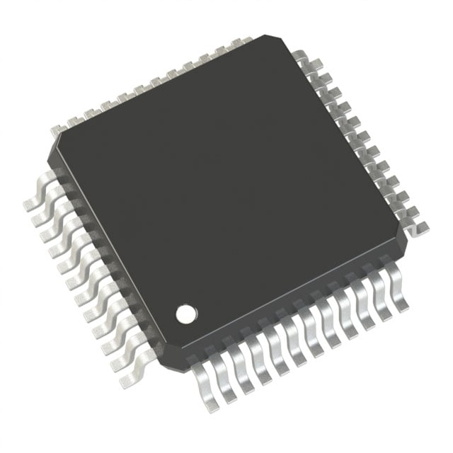
Overview
Using the STM32G491ME
Smaller and cheaper package
Not the H7
Student Organization for Aerospace Research

Slide 27
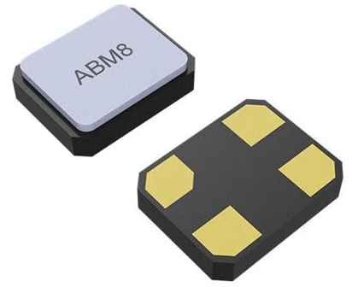
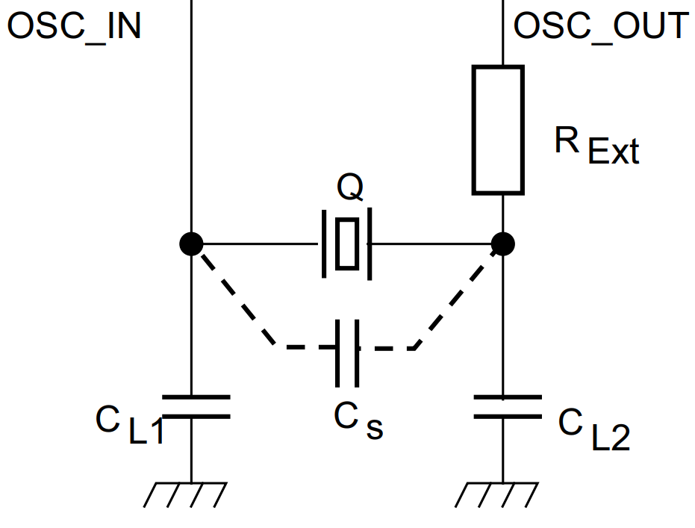
Oscillator
Using the ABM8-32.000MHZ-B2-T https://www.digikey.ca/en/products/detail/abracon-llc/ABM8-32-000MHZ-B2-T/2001197
Oscillator has C_{L}=18pF, and C_{S}=6pF
For C_{L1} and C_{L2} = 24pF based on CL1​=CL2​=2∗(CL​−CS​)
The STM specifies G_{m,crit}=1.5mA/V
With CL1/CL2, G_{m,crit,osc}=2.8524mA/V
RExt=221Ω, see https://www.st.com/resource/en/application_note/an2867-guidelines-for-oscillator-design-on-stm8afals-and-stm32-mcusmpus-stmicroelectronics.pdf
Student Organization for Aerospace Research

Slide 28
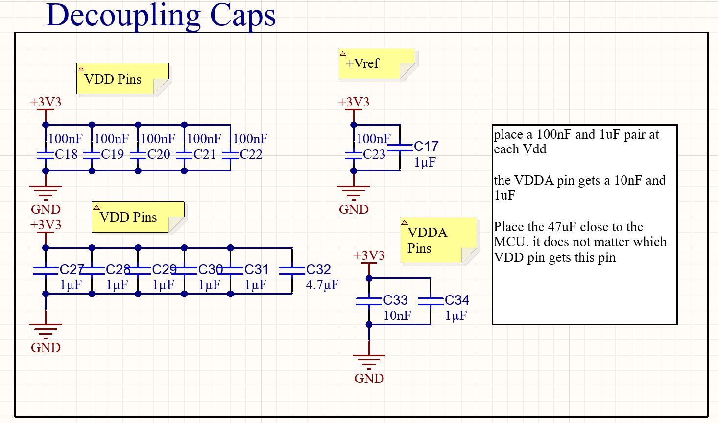
Power Supply
STM takes 1.7V-3.6V, it’s connected to 3V3 line
Lots of Caps
Student Organization for Aerospace Research

Slide 29
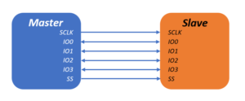
Connectivity Memory
Flash memory uses Quad SPI 1
PE12:IO0
PB0:IO1
PE14:IO2
PE15:IO3
PE10:CLK
PE11:NCS
Student Organization for Aerospace Research

Slide 30
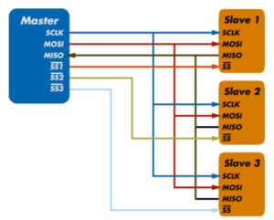
Connectivity Thermocouples
Thermocouples connect to SPI1 and use 9 GPIOs for TC1, TC2, TC3 respectively:
CS (SS): PD2, PB6, PD9
nDRDY: PB4, PB7, PD8
nFault: PD1, PB5, PD10
Student Organization for Aerospace Research

Slide 31
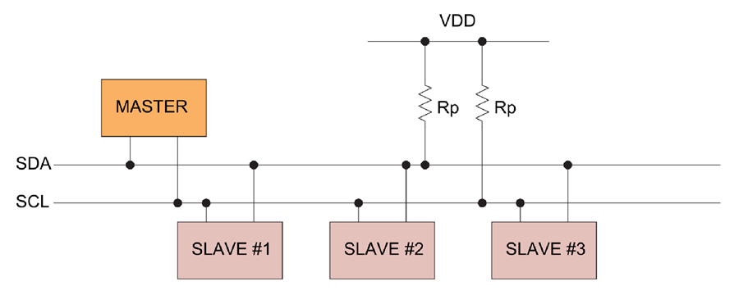
Connectivity Load Cells
Load Cells connect to I2C3 and use:
SDA: PC9
SCL: PC8
Rp=4.7kΩ
Student Organization for Aerospace Research

Slide 32
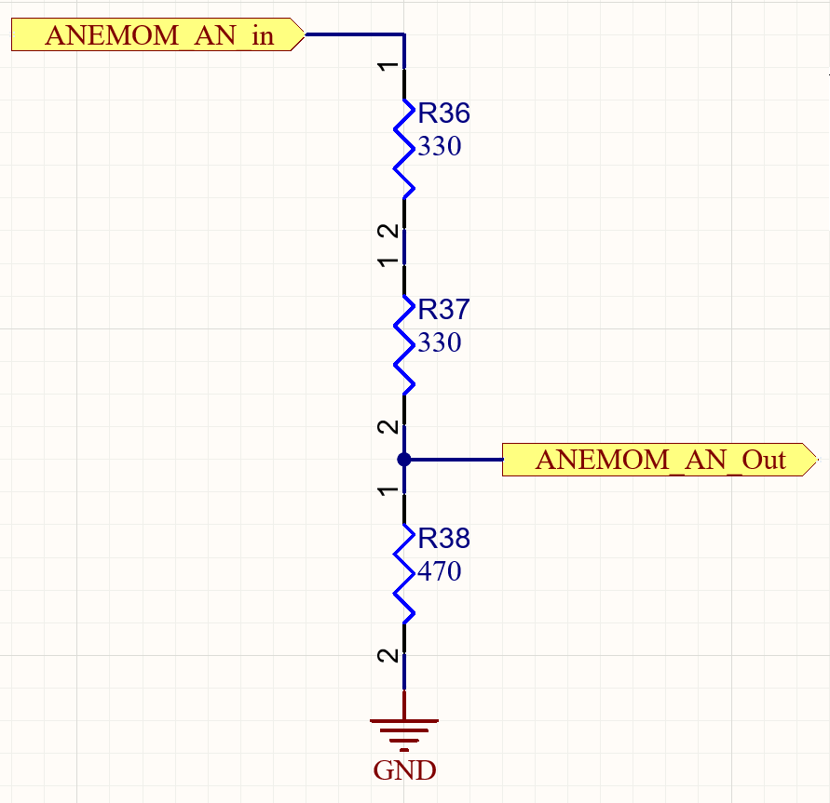
Connectivity Anemometer
Anemometer use ADC1 IN1 on pins:
PA0: AN+
PA1: AN-
AN- has 0Ω jumper to ground if sensor only provides single ended.
Student Organization for Aerospace Research

Slide 33
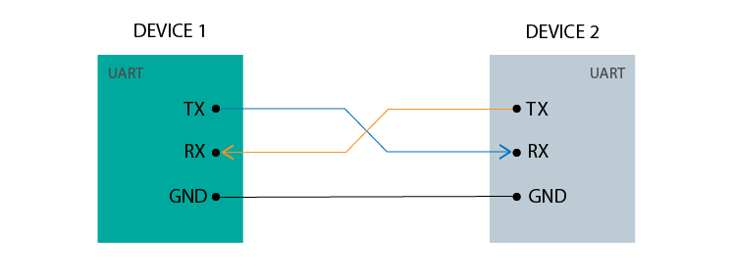
Connectivity FSB
FSB connects using USART3 in async mode:
UART Tx: PB10
UART Rx: PB11
RS-485 DE: PB14
Can use built in DE hardware flow control for UART to RS-485 chip
Student Organization for Aerospace Research

Slide 34
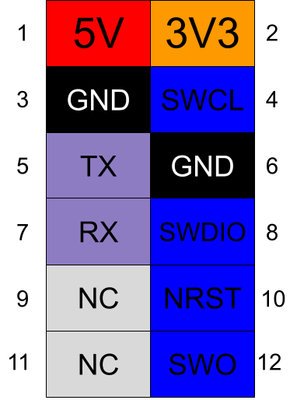
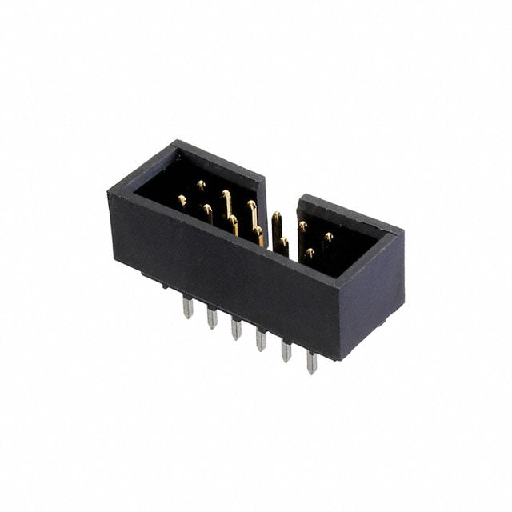
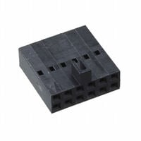
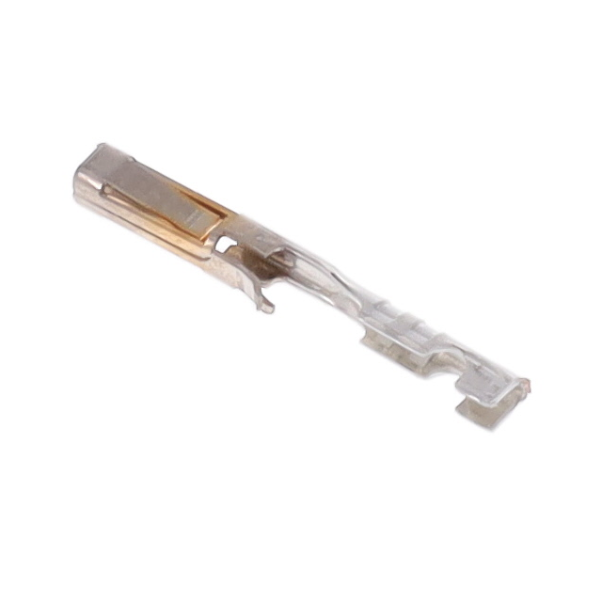
Programming
Use 12 pin keyed 2.54mm molex connector for Serial Wire Debug Programming protocol
0702461201:
https://www.digikey.ca/en/products/detail/molex/0702461201/760167
0022552122:
https://www.digikey.ca/en/products/detail/molex/0022552122/313630
0016020074:
https://www.digikey.ca/en/products/detail/molex/0016020074/4838840
Student Organization for Aerospace Research

Slide 35
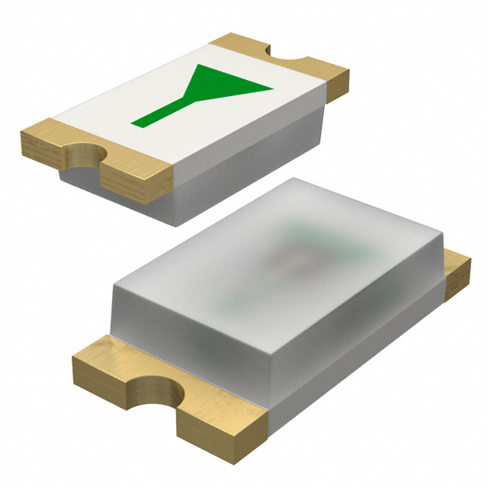
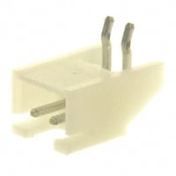
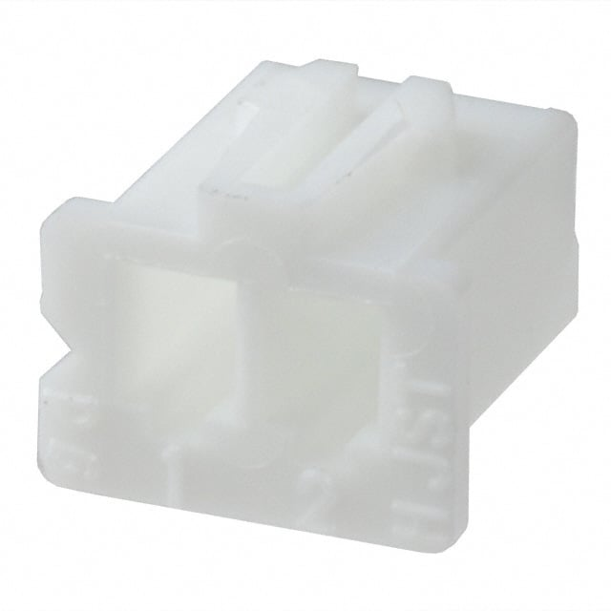
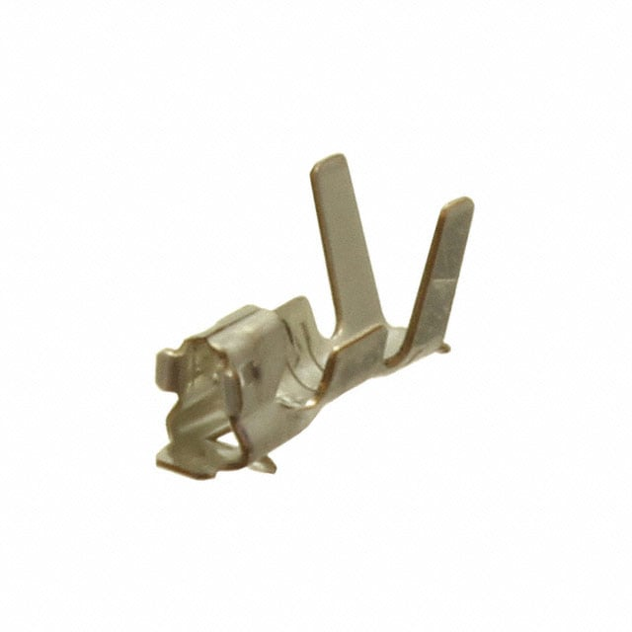
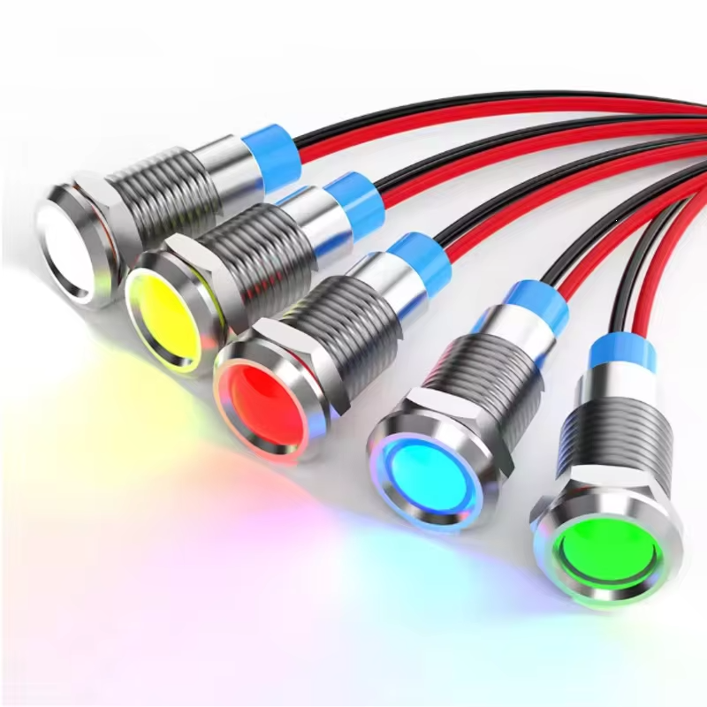
Debug
Programming Debug UART uses USART2 (PA2:Tx, PA3:Rx)
Debug LEDs
On board 3x: PC13, PC14, PC15
External (box edge) LEDs: PA15, PC10, PC11, PC12, PD0
S2B-XH-A
XHP-2
SXH-001T-P0.6N
https://www.aliexpress.com/item/1005009023296115.html
Student Organization for Aerospace Research

Slide 36
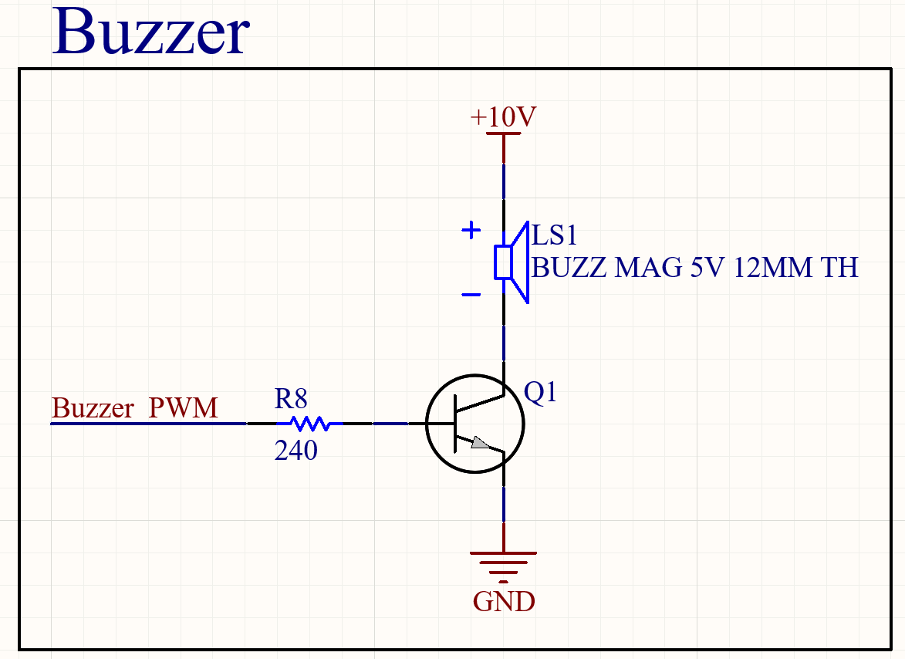
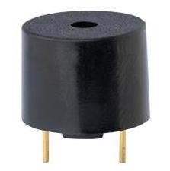
Debug Buzzer
Debug Buzzer Same Sky CMI-1210-5-95T
Connects to PWM PC0: TIM1, PWM Gen CH1
95dB, plug your ears
Student Organization for Aerospace Research

Slide 37
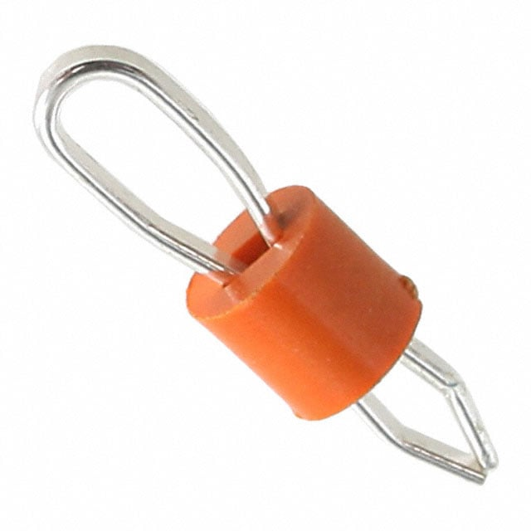
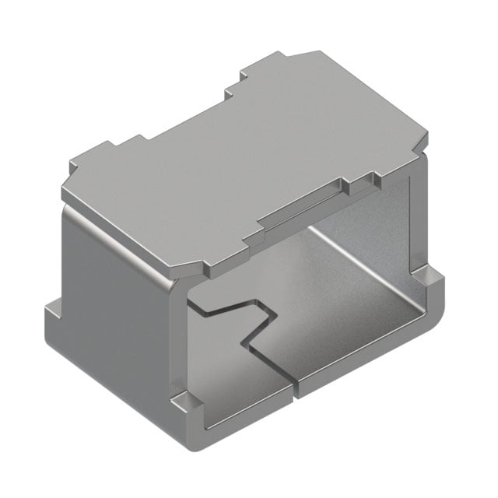
Debug Test Points
Power Test Points (Stupid Orange Ones):
10V, 5V-FSB, VBUS-USB, 5V, 3V3
Signal Test Points (1206 Clips):
I2C lines
SPI lines (including CS)
Debug UART
and FSB UART (with DE)
Student Organization for Aerospace Research

Slide 38
Research Mission
THE END
Student Organization for Aerospace Research

